Slide 1
Breast Cancer
Survival
Exploratory Data Analysis

Slide 2
Problem Statement
The dataset contains cases from a study that was conducted between 1958 and 1970 at the University of Chicago's Billings Hospital on the survival of patients who had undergone surgery for breast cancer.
We have to perform Diagnostic Analysis in order to find patterns among the data.

Slide 3
Data Description
Age - Age of the patient at the time of operation
Year - Year in which the operation was performed
Positive axillary nodes - Number of positive axillary nodes detected in the patient’s body.
Survival Status - Class Attribute:
-- 1 = The patient survived 5 years or longer
-- 2 = The patient died within 5 year

Slide 4
Basic Information derived from the Dataset
The dataset comprises of 306 records and 4 columns.
No missing values were found.

Slide 5
Exploratory Data Analysis
On checking the overall distribution of data:
- Pos_axillary_nodes is Positively Skewed as Mean (=4.026) > Median (=1)
- The total percentage of outliers was found to be 13.07%

Slide 6
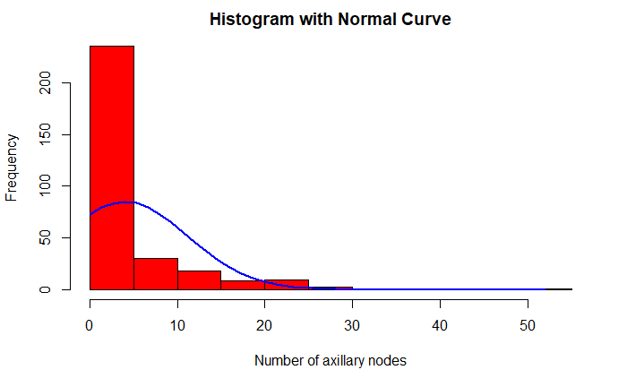
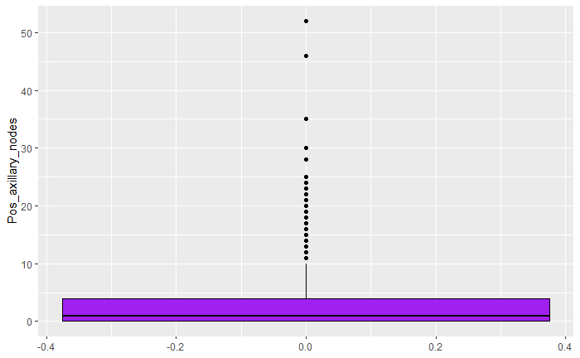
The Original Distribution

Slide 7
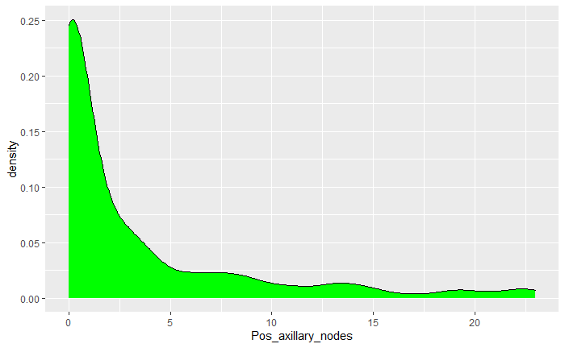
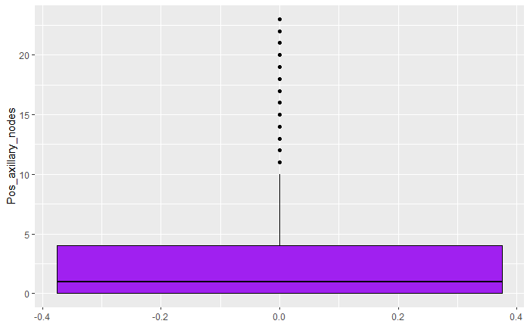
Distribution after Skewness Correction

Slide 8
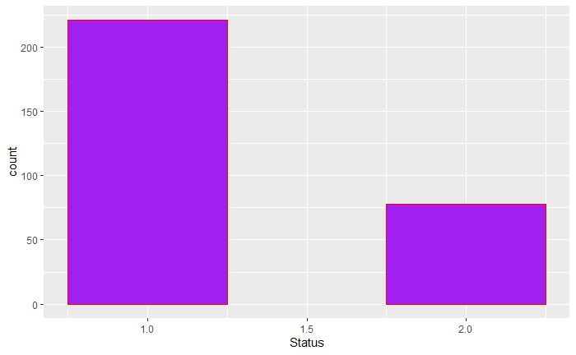
1. Of all the patients, how many survived?

Slide 9
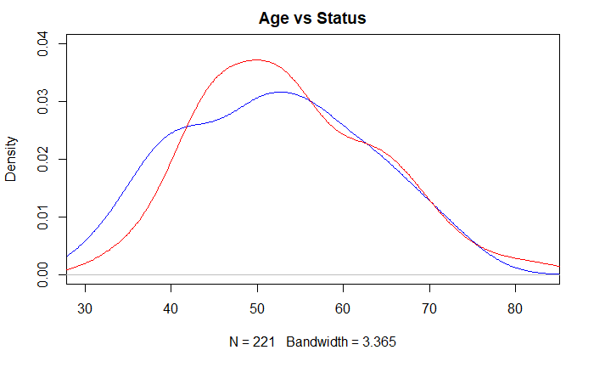
2. Lets check the relation between Age and Status

Slide 10
We can divide the age into groups for better analysis. - Group 1: ages 30-43 - Group 2: ages 44-57 - Group 3: ages 58-71 - Group 4: ages 72 and above
2. Lets check the relation between Age and Status

Slide 11
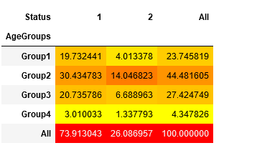
2. Lets check the relation between Age and Status

Slide 12
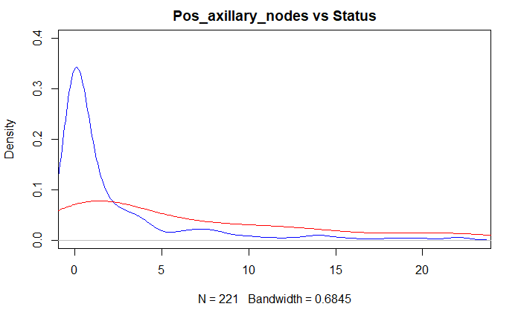
3. Lets check the relation between Pos_axillary_nodes and Status.

Slide 13
We can divide the age into groups for better analysis. - Group 1: nodes between 0-5 - Group 2: nodes between 6-11 - Group 3: nodes between 12-17 - Group 4: nodes more than 18
3. Lets check the relation between Pos_axillary_nodes and Status.

Slide 14
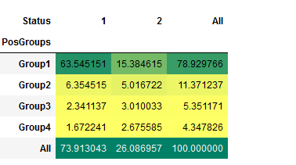
3. Lets check the relation between Pos_axillary_nodes and Status.

Slide 15
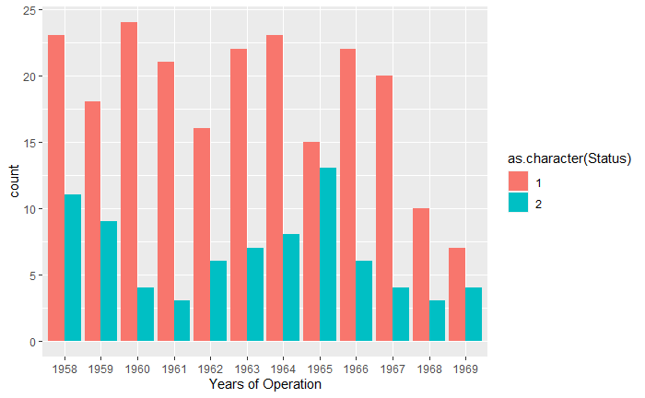
4. Lets check the relation between Years_of_operation and Status

Slide 16
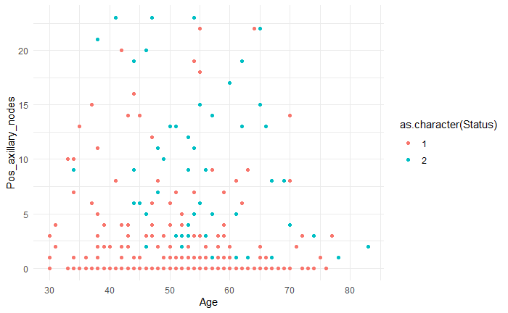
5. Lets check the relation between Age, Pos_axillary_nodes and Status

Slide 17
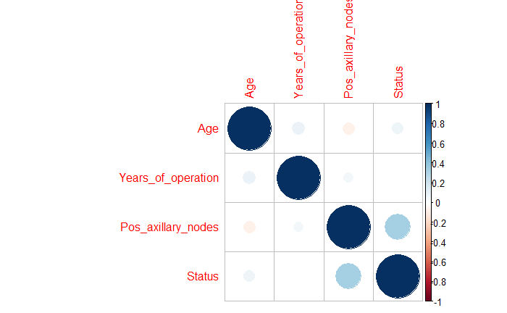
6. Let us check the correlation between all the variables using a Heatmap.

Slide 18
End Results
1. There were outliers in Pos_axillary_nodes field, which constituted 13.07% of the total values. Around 2.29% values were removed to correct the skewness a bit and prevent excess loss of information.
2. In the dataset at hand, 73.5% patients survived for more than 5 years.

Slide 19
End Results
3. Majority of the patients belong to Ages between 44-57 (~44.5%), out of which 30.43% lived for more than 5 years after their operation.
In general, throughout all ages, We had more patients surviving for more than 5 years after operation.
4. Majority of the patients with less number of axillary nodes (0-5), survived for more than 5 years after the operation.

Slide 20
Hypothesis Derived
a. Patients throughout all ages, for lesser number of positive axillary nodes (between 0-5) present,
or
b. Patients in the younger age group (between 30-45), throughout all values of positive axillary nodes,
have higher chances of surviving beyond 5 years post operation.

Slide 21
Thank You

